Slide 1
HCS12 MicroMOUSE
A presentation by MADZIVIRE CHIKWANDA and ABEL DELGADO

Slide 2


Slide 3

Project planning
Bluetooth and Algorithm
Bluetooth module
Additional sensors
New chassis
Review
Bluetooth tech

Slide 4

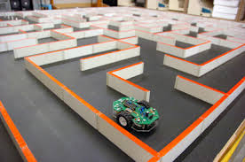
Work Breakdown
Abel
Madzivire
Bluetooth connection
Phone application
Maze algorithm
Extra parts

Slide 5
Work schedule

Slide 6
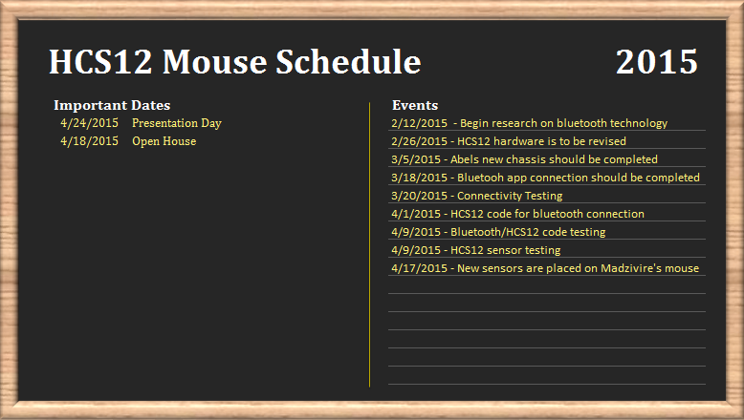

Slide 7
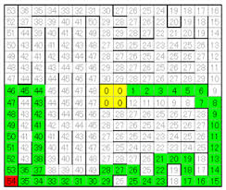
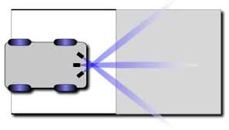

Slide 8
Knowledge from Other Courses
CENG 300 Software Project
CENG 302 Systems Analysis
CENG 208 Micro Assembly Language Program
TECH 150 Electronic Devices & Circuits
CENG 512 Hardware Production Technology

Slide 9
Knowledge from Other Courses
510 – Algorithms and Data StructureCENG 302 Systems Analysis
306 – Digital Interface SystemsTECH 150 Electronic Devices & Circuits
302 – System Analysis
208 – Micro Assembly Language Programing
Tech 103 – Technical C

Slide 10
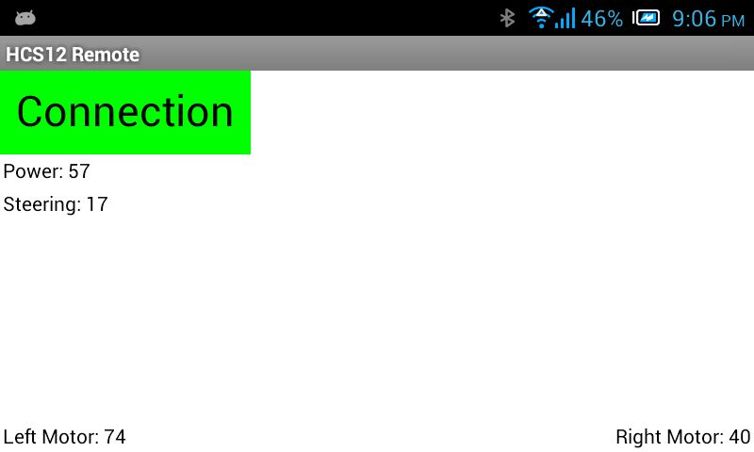
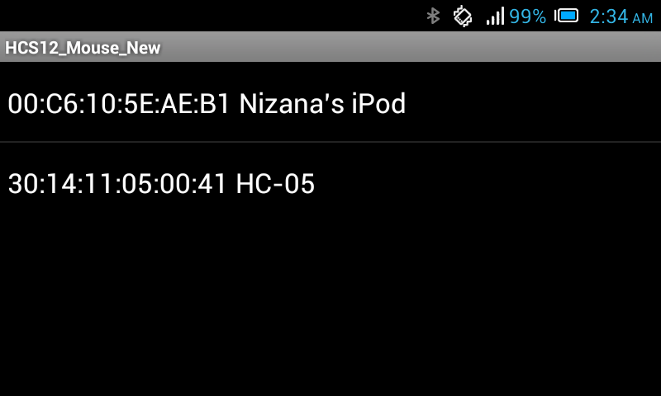

Slide 11
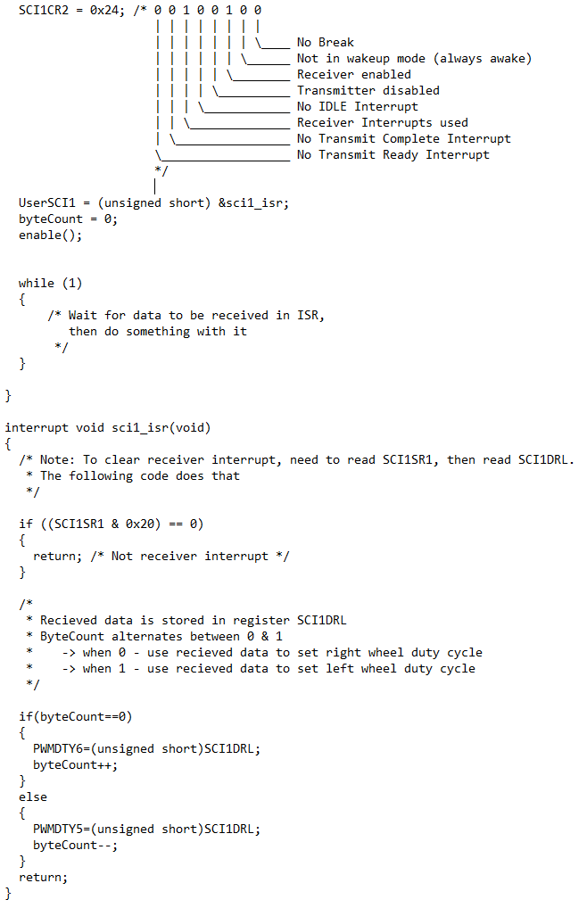

Slide 13


Slide 14
Questions??

Slide 15
THE END

